Slide 1
SOME FACTS ABOUT KVAH BILLING

Slide 2
Forum of Regulators (FOR), has recommended kVAh billing stating that kVAh billing is the new trend in electricity billing, which is adopted worldwide.
The DISCOMs across the country are in the process of switching over to KVAh based tariff billing for HT consumers. Electricity Regulatory Commissions in States viz. Himachal Pradesh, Delhi, Uttar Pradesh, Jammu & Kashmir, Andhra Pradesh, Chhattisgarh, Bihar, Haryana, Punjab have introduced kVAh based tariff in their recent tariff orders.

Slide 3
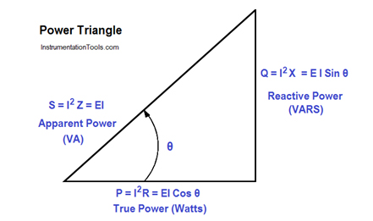
POWER CONSISTS OF TWO COMPONENTS
Active Energy (kWh) and
Reactive Energy (kVArh).
Vector sum of these two components is called Apparent Energy and is measured in terms of KVAh

Slide 4
Reactive Power comes with the Real Power. It is useful for creating magnetic flux to run electrical machines. However, the quantum of Reactive Power required generating flux is lesser. The balance reactive current flows in the system and makes system components such as relays, switches, NO/NC contacts sluggish and insensitive. High Reactive Power is also a cause of poor power factor. It is therefore desired to have minimum reactive power or ideally zero reactive power. The power factor is unity at zero reactive power. Ideally the power factor is required to be unity. However, the power factor is leading if the load is predominantly capacitive and lagging if the load is predominantly inductive. PF incentives are given on electricity bill if the Power Factor is between 0.95 to 1. On other hand, penalties are levied if the Power Factor is below 0.85. It is therefore required that consumer should maintain higher power factor above 0.95 through proper compensation.

Slide 5
KVAH billing will ensure that the consumers who utilize the power efficiently will be paying less energy charges as compared to others who are not using the power efficiently. The new billing methodology will be much simpler to understand as number of parameters viz. PF, rkvah (lead/lag), kwh units will be reduced.

Slide 6
KVAh billing has an inherent mechanism to incentivize or penalize consumers according to their power factor. High harmonics, especially induced due to low power factor create disturbances in the system and harm sensitive equipments. Besides that, Transformers, Cables and Switch Gears can be utilized to its optimum capacity by maintaining near Unity Power Factor.

Slide 7
The Prime Objective of the kVAh based billing is to encourage the consumers to maintain near unity Power factor to achieve loss reduction, improve system stability, power quality and improve voltage profile. At the national level, emphasis is being given to Energy Conservation, Energy Efficiency and Demand Side Management (DSM) to optimize the energy usage. Through kVAh billing, the consumers will be encouraged to adopt energy efficiency programs and will be benefited by reduced electricity bills.

Slide 8
WE THANK YOU FOR VIEWING
THIS SHORT VIDEO AND
FOR YOUR TIME

